Slide 1

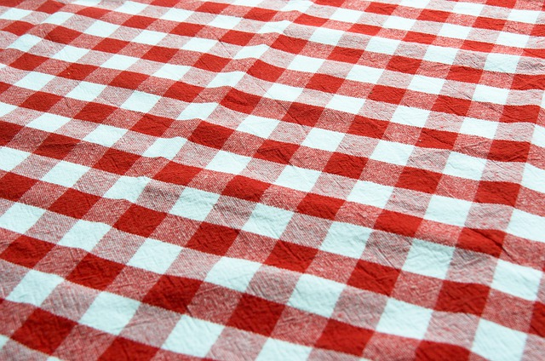
Interface Design
Audience:
Each game is designed for all ages.
Interactive Features:
Game cards (with game logos) that when clicked, go to game page, (also added hover animation).
Side navigation menu that shows directions for each game.
Close button for side navigation menu.

Slide 2
Interface Design
Layout Selection:
Used flexible design on all elements including game cards and captions, using responsive attributes and media queries to be mobile-friendly.
Set everything to box-sizing: border-box to make it easier to account for total widths of all elements.
Color Scheme:
I wanted everything to seem cohesive and since each game is food-themed, I found a tablecloth image to use as the background image of the main page as well as in some of the game logos.
I used colors from each of the images/logos for fonts and background colors.

Slide 3
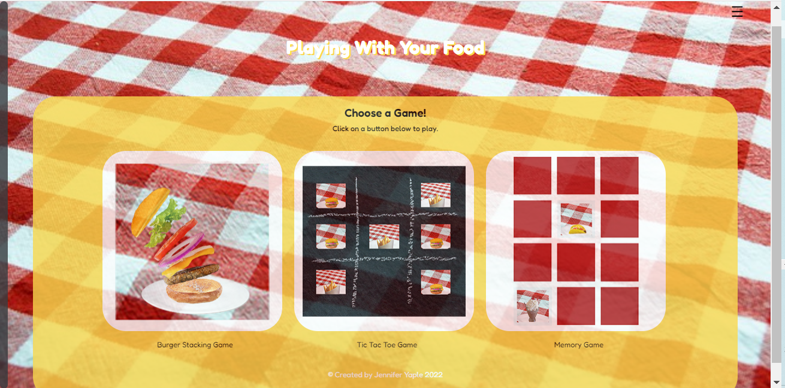
Interface Design
I wanted to make some fun and easy games that people of all ages could play.
whether it’s an adult wanting a mindless distraction, or a kid whose parent just wants to keep them occupied so they can have a few minutes of peace, these games are for everyone.

Slide 4
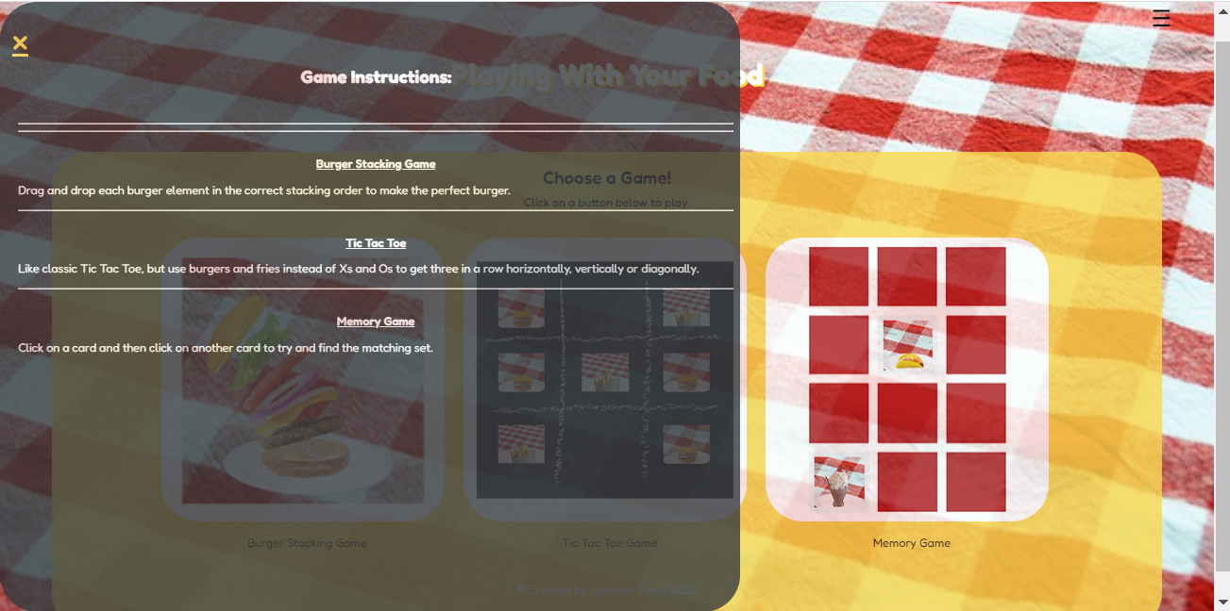
SideNav Menu Design
The hamburger menu icon, when clicked, shows the rules of each game.
I added a close button and some sliding animation.
This was created using JavaScript.
document.getElementById("open").addEventListener("click", openNav);
document.getElementById("close").addEventListener("click", closeNav);
function openNav() {
document.getElementById("mySideNav").style.width = "60vw";
document.getElementById("main").style.marginleft = "60vw";
}
function closeNav() {
document.getElementById("mySideNav").style.width = "0";
document.getElementById("main").style.marginleft = "0";
}

Slide 5
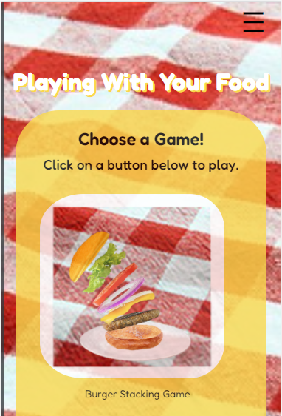
Mobile View
Used media queries for responsiveness. (View pictured is iPhone4)
@media only screen and (max-width:600px) {
.main{
width: 90vw; //used vw instead of % to make sure the main part of
} //the page resized in response to the size of the
figure{ //screen it’s being viewed on.
width: 100%;
} //for the game card images, although I used vw widths
figure img{ //in the main CSS, for the mobile view I wanted them
width: 85%; //to be in relation to the parent element’s width.
margin-right: 3px;
padding: 10px 10px 10px 0px;
}
figcaption{
font-size: .75em;
padding: 0px 0px 10px 0px;
}
h1{
font-size: 1.75em;
text-shadow: 2px 2px rgb(249, 216, 77); //sampled color from the
} //cheese image
h2{
font-size: 1.25em;
}
h3{
font-size: 1em;
}
footer{
font-size: .75em;
}

Slide 6
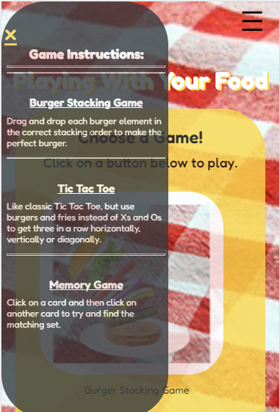
Mobile View
Used media queries for responsiveness. (View pictured is iPhone4)
#open{
font-size: 2em;
}
.closebtn{
font-size: 2em;
}
.directions{
font-size: .65em;
padding: 3px;
}
.gameTitle{
font-size: 1.25em;
line-height: .5em;
}
.instructions{
font-size: 1.5em;
line-height: .5em;
}
}

Slide 7
* I had a hard time getting the images to fit on the cards without looking warped. * I also struggled getting the positioning right for each of the game cards and having the words line up with the cards above them. In order to keep the words in line with the images I decided to use the <figure>and <figcaption>tags. HTML: <div id="container"> <figure> <img type="image" src="media/burgerStackingGameLogo.jpg" alt="Burger Stacking Game Logo"> <figcaption>Burger Stacking Game</figcaption> </figure> <figure> <img type="image" src="media/ticTestLogo.jpg" alt="Tic Tac Toe Game Logo"> <figcaption>Tic Tac Toe Game</figcaption> </figure> <figure> <img type="image" src="media/memoryGameLogo.jpg" alt="Memory Game Logo"> <figcaption>Memory Game</figcaption> </figure> </div>
Jflkjfoije;laj
Coding Issues:

Slide 8
CSS: #container{ margin-left: 7%; margin-right: 5%; text-align: center; padding: 2%; } figure{ width: 23vw; //wanted width based on screen size not parent element’s size (mobile view based on parent-size) float: left; margin: 0 1% 0 1%; } figure img{ display: inline-block; //so they can be next to each other and have specified dimensions vertical-align: middle; //center the image on the card vertically object-position: center; //center the image on the card horizontally object-fit: contain; //image should be the largest size that will fit within the border-radius: 50px; //element's box without altering its aspect ratio width: 100%; margin: none; } figcaption{ padding: 5% 10% 0 13%; }
Coding Issues:
Jflkjfoije;laj

Slide 9
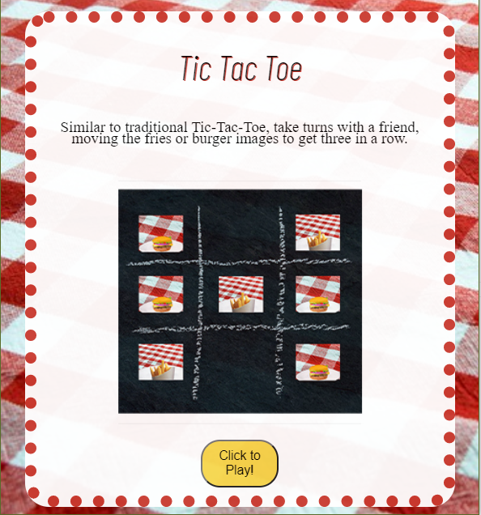
Game Card Links
The game cards, when clicked, open to a new page with a brief description and game directions.
From there, you can click on a “Click to Play!” button to navigate to the game page.
This was created using JavaScript.
//links to game pages
document.getElementById("burger").addEventListener("click", function(){
location.assign("https://lisabalbach.com/yaple3/CIT190/FinalProject/burgerStacker.html");
});
document.getElementById("tic").addEventListener("click", function(){
location.assign("https://lisabalbach.com/yaple3/CIT190/FinalProject/ticTacToe.html");
});
document.getElementById("memory").addEventListener("click", function(){
location.assign("https://lisabalbach.com/yaple3/CIT190/FinalProject/memoryGame.html");
});

Slide 10
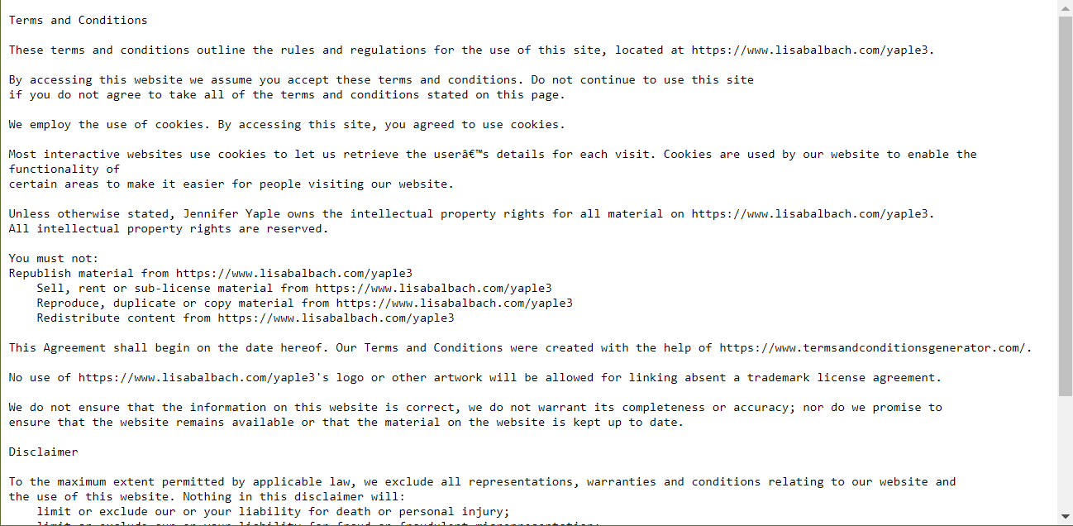
Footer with readme copyright info
I decided to put the link to the readme.txt file with the copyright info in the footer.
On the page the footer shows the copyright symbol with my name and the year, but when you click on it, the readme file opens up in a new window with the extended information.
This was created using JavaScript.
//link to readme file in footer
document.getElementById("footer").addEventListener("click", function(){
window.open("https://lisabalbach.com/yaple3/CIT190/FinalProject/readmeCopyrightInfo.txt");
});

